Slide 1



TV: It’s for everyone
Harry Ward Masters
Agency Relationship Manager
Hotels.com, ‘Big Sampson’

Slide 2



















1. Who is Thinkbox?
Thinkbox is the marketing body for commercial TV in the UK, in all its forms. It works with the marketing community with a single ambition: to help advertisers get the best out of today’s TV.
Main shareholders
Associates & supporters
Member of

Slide 3

What we’ll be covering…
1. VIEWING LANDSCAPE
2. TV: THE BASICS
3. ADVANCED TV
4. IT’S FOR EVERYONE NO MATTER THE BUDGET
5. THE BUSINESS CASE FOR ADVERTISING
On Running - Roger

Slide 4

1. VIEWING LANDSCAPE
Beavertown, ‘For Humans and other social beings’

Slide 5
The world of TV has expanded
TV-set viewing time by platform (All Adults)
2015
2023
3hrs 46 mins
PER DAY
3hrs 34 mins
PER DAY
Source: Barb / Touchpoints
Notes:
To understand where TV is going, we need to look at where we’ve come from and where we are now.
This was TV in 2015 – almost entirely dominated by linear.
This is TV last year – linear still accounts for the lions share, but the world of TV has significantly expanded.
For advertisers, the challenge is that the new players took viewing away from the ad-supported world, but that’s about to change.

Slide 6
VOD remains in a rapid growth phase
- 6%
+ 9%
+ 25%
+ 36%
Source: Barb, All Adults, TV set viewing
Notes:
In terms of the direction of travel, we’re going to see continued shifts in viewing.
We’re watching less linear TV as viewing shifts to video on demand – a trend that will continue
Broadcaster VOD grew by 23% in 2023 and so far this year it’s remained in this rapid growth phase – up 25%.
All the TV companies have invested in their streaming positions and it’s paying off.
C4 has had a great start to the year – streaming minutes up 35%
ITV X is reaching 21 million viewers a month
Sky have clocked up well over 1 billion hrs of steaming already this year – significantly up yoy
SVOD subscriptions are pretty flat, but their collective viewing is increasing up 9% so far this year.
And as well documented, the TV set is a growth area for YouTube (it’s still relatively small at 13 mins per person per day), a part of this is down to the TV businesses increasingly using YouTube as a distribution platform
- Sky News is the number one UK news channel on YouTube and the premier league highlights have clocked up over 500m views so far this year
- UK views of Channel 4 full episode content on YouTube up 331% year-on-year
Other AVOD – lots of noise, but insignificant in the UK as yet

Slide 7
Ad-supported TV is increasing
% of all viewing to TV content
All Adults
16-34s
Source: Barb – TV set viewing (Jan to July 2024 Vs Jan to July 2023)
Notes:
From an advertising perspective, the most important change is that viewing to ad-supported TV is on the up.
The SVODs originally shifted viewing out of ad supported TV, into an ad free environment, making it harder to reach all corners of the UK in the quality environment TV delivers.
With the SVODs launching their ad tiers late last year, we’re seeing a reversal in the trend.
New Barb data tells us that there are 2.8m Netflix homes on the Ad tier – 800k Disney+ homes and we estimate that most Amazon prime video homes are on the default ad tier – so roughly 12 million households.
Amongst adults it’s a subtle shift, 61% of all viewing is now to ad supported content, up from 58% last year.
For younger audiences it’s more significant – ad supported viewing moving up from 40% to 48%

Slide 8
Reach potential in ad-supported TV is increasing
AVE MINS OF AV ADVERTISING WATCHED PER DAY
Source: Barb – July 2024, Adults, TV set viewing, deciles ranked on weight of viewing to TV Set viewing (linear, BVOD, SVOD, and video-sharing)
Notes:
To understand reach potential, it’s much easier to break viewers up in terms of their weight of viewing – some people watch a lot of video, some people don’t watch much at all and broad averages can hide this.
Here we’ve split the UK video viewing population into 10 groups from lightest to heaviest. Each group consists of just under 5 million adults and we’ve broken down the % of time they spend watching ad-supported content on their TV set.
On the right the heaviest viewers watch a lot – they see 55 mins of ads in the average day. Think it’s fair to say they’re easy to reach. At the other end we have the lightest 10% who see less than one minute of ads per day on their TV – fair to say they’re hard to reach.
What this chart makes clear though is that lighter viewers watch a higher % of video on demand – and so the addition of the light pink chunk of SVOD ad tier viewing means that there are more opportunities to grow reach in a professionally produced TV content environment, that delivers all the qualities that Peter, Rich and Claire talked about earlier – trust, emotion, attention, signalling strength, cultural power & influence.
Advertisers should be maximising the reach in the most effective environment - If TV-quality reach potential is growing, so too should TV budgets.

Slide 9
VOD is enabling us to watch more Drama, Ents and Film
Entertainment
Drama
News
Sport
Documentaries
Hobbies
Films
Current Affairs
Children
Music
MINUTES PER PERSON PER DAY
Source: Barb - TV set only, Individuals

Slide 10
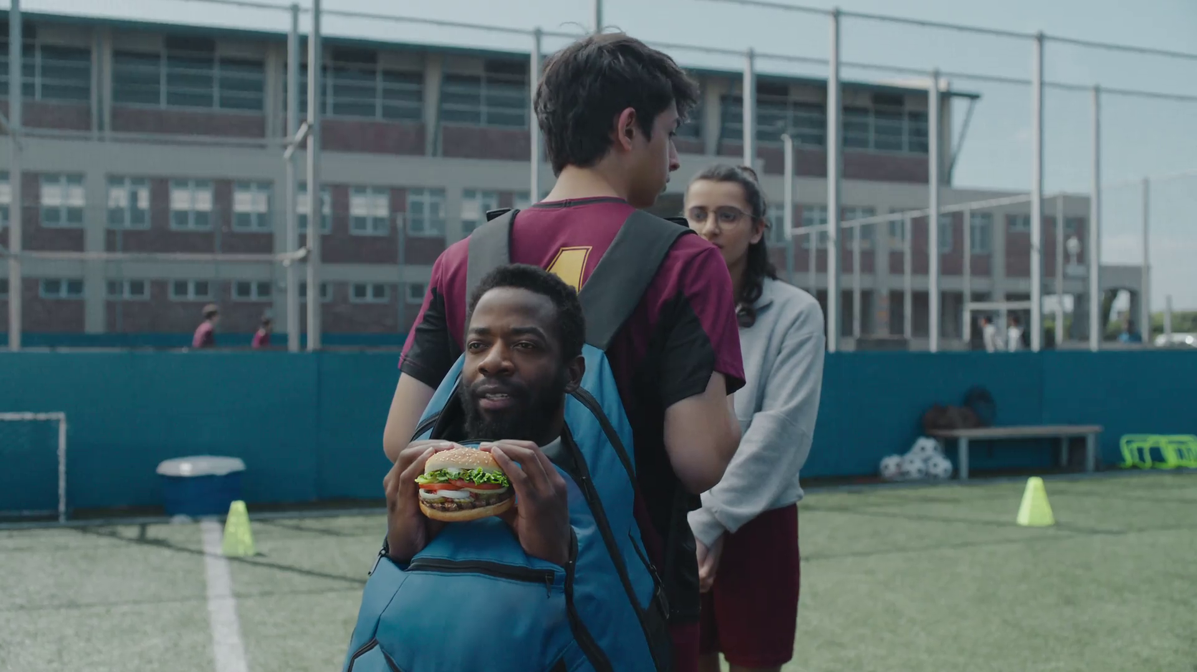
2. TV: THE BASICS
Burger King, ‘First Kiss’

Slide 11
TV population (universe) sizes in millions
60.9
51.7
29.2
26.7
25.0
14.3
9.2
6.7
Individuals
Adults
ABC1 Adults
Women
Men
16-34 Adults
Kids
Housepersons
with Kids
Sources: Barb, Dec 2023
Notes:
In 2023, the population of people aged 4+ with access to a TV set was 60.9m.

Slide 12
Commercial linear TV daily, weekly & monthly reach
Reach % | Daily | Weekly | Monthly
Individuals | 49.1 | 73.8 | 86.7
Adults | 53.7 | 77.0 | 88.2
ABC1 adults | 49.6 | 75.2 | 87.4
16-34 | 28.1 | 57.1 | 76.8
Men | 52.2 | 75.9 | 87.2
Women | 55.2 | 78.1 | 89.2
HP+CH | 44.9 | 72.4 | 86.4
Source: Barb 2023, industry standard TV viewing in-home on a TV set. Reach 3min+
Notes:
Commercial Linear TV reaches 74% of the population each week.

Slide 13
Total linear TV daily, weekly & monthly reach
% of the UK population
57.0%
79.4%
90.5%
Daily
Weekly
Monthly
Source: Barb, Total TV, 2023, reach 3+ mins, Individuals
Notes:
Total Linear TV reaches 79% of the population each week.

Slide 14
How we watch broadcaster TV
Inds
16-34
2 hrs 40 mins
1 hr 5 mins
Source: 2023, Barb
Notes:
BVOD is vital to different audiences
Breaking down broadcaster TV into the different ways reveals the increasingly important role of BVOD for 16-34, now 24% of all broadcaster TV viewing.
This data uses both Barb data and includes an estimate of any unknown viewing that is thought to fall into Playback and Live viewing.

Slide 15
The main players
Notes:
These guys represent about 98% of the UK TV ad market. And are the main sales house you’d likely be buying inventory from.
Channel 4 is made up of Channel 4 main, 4Seven, E4, E4 extra, Film4, More4 and Channel 4 Streaming. They also act as the sales house for UKTV.
ITV is made up of ITV 1, ITV2, ITVbe, ITV3, ITV4 and ITVX
Sky represents over 130 different channels int eh UK. You’ve got things like Sky Sports, Sky Movies and Sky Atlantic. They are sell on behalf of Channels like Channel 5, Kids channels like Cartoon Network, Warner Brothers Discovery channels like Comedy Central and Discovery.
UKTV, First created by BBC Studios in 1992. they have recently had a rebrand and the channels they cover are U&Gold, U&Dave, yesterday, W, Eden, Alibi and they have their on demand catch up service U Player. All of these channels are sold by Channel 4.

Slide 16




The SVODs
Notes:
And the TV market isn’t just TV Channels any more. As a great women (Tess Alps, our former CEO) said ‘TV isn’t dying, it’s just having lots of little babies’ and these Streamers are an example of these babies.
When they first launched, they were ad free environments. But at the back end of last year and the start of this, they all launched ad supported tiers. And they joined the fight as Thinkbox associate members, rubber stamping themselves as TV and aligning themselves with our TV companies as being something totally different to the video offerings on the market like that namely of YouTube.

Slide 17
TV Buying Audiences
Broads
Upmarkets
Youngs
ABC1Adults
ABC1Men
ABC1Women
ABC1 Housepersons
Adult1634
Women1634
Men1634
Adults
Women
Men
Kids
Housepersons
Housepersons with Kids

Slide 18

Linear Spot
Typical ad breaks across TV.
Brought in advance of the month starting.
Brought against sociodemographic audiences.
Brought against impacts and TVRs.
You can select programming which matters the most.
Can be brought across regions to make the budget go further.
Pricing changes on supply and demand.
Milliways, ‘Strange, isn’t it’
Notes:
Your linear campaign would be placed in spots in what we call Centre or End breaks. Centre break is as the name implies, it’s a break in the middle of a break, these normally sit at the 15-minute mark, so 21:15, 21:30, 21:45. An end break is a commercial break that comes at the end of the clock hour on TV. So it would be the break that links one show into another. Centre breaks tend to be more desirable and therefore cost more than end breaks depending on the time of day and lead in program.
Linear TV has a lot more moving pieces so it requires a little more time to set up and get running. All of the main saleshouse will likely require your campaign information like budget, channels running and campaign dates a month before the start of the month. You can still send it after a certain date each month or even in month, but you may not have access to the highest rating programming or have to pay additional charge of being late in the market.
You buy a linear TV campaign against sociodemographic audiences like the one of the pervious slide. While your media agency might plan against an adult 25-35 audience, they won't be able to buy against that audiences. So in that example, you’d likely be buying an ABC1adult audience.
When you’re buying a TV campaign, you’d be buying a TVR target. A TVR stands for Television Rating, it is basically a percentage of the total audience that is watching TV at any one time. So for example if 100 people are watching TV at 6pm and 10 of them watch the news that would be a TVR of 10, as 10% of the audience has watched. When you buy against these audiences, you are buying the whole audience and then some of them will watch.
With a spot campaign, you will likely have the option to move your spots around to get into the shows that you’re keen to get into providing you can afford them and the broadcasters can make the moves happen. This is a process called a Turnaround.
With a spot campaign, you have the ability to buy into macro regions around the country. For example, if you have a book that you know will sell well in Yorkshire for example, you can select regions that would cover this area only. This is one of the things that we talk about as one of our planning principles, if you can, go big in a small area and own it. This is something that we’ve seen to good effect from brands in Scotland or ones that are looking to own an area.
TV’s pricing is dynamic and is linked to supply and demand, when there is a high level of spend in the market, your pricing will be higher. This will happen the most in the build up to Christmas when large numbers of advertisers start to spend on TV across every sector. When viewing is high, your pricing will drop as more people are watching, this will happen in the post-Christmas period and colder months of the year when viewing is higher due to a wider range of content and more people at home.

Slide 19
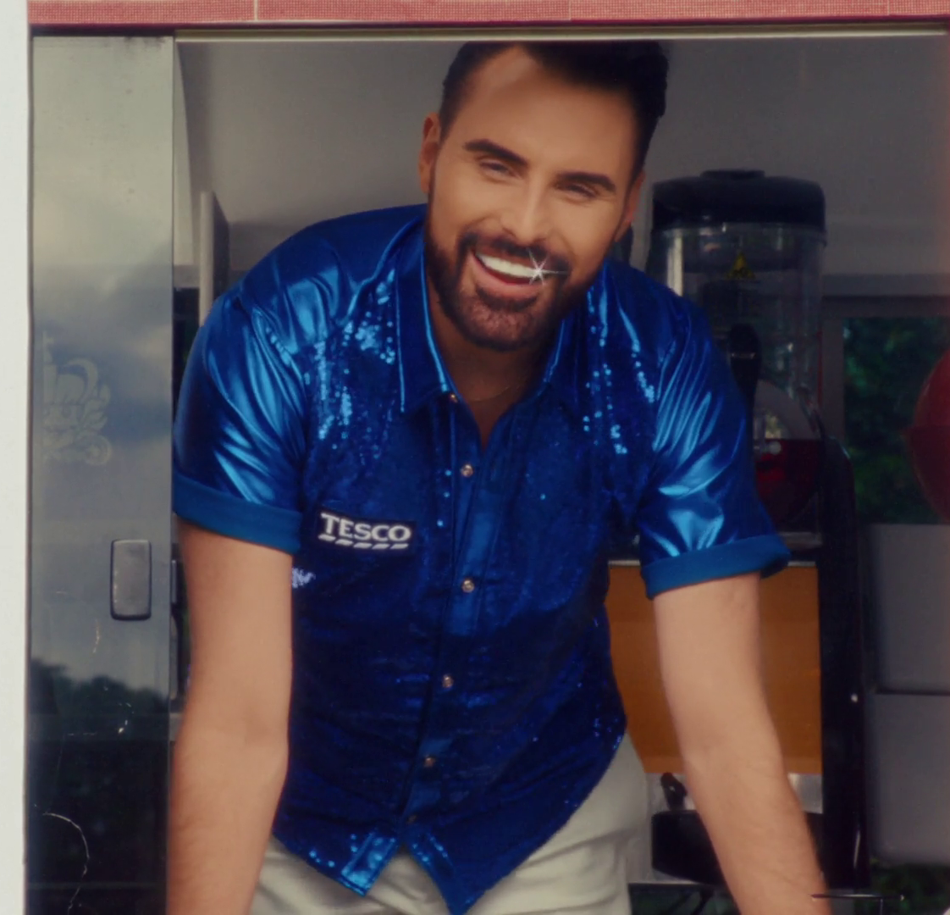
BVOD
Spots are before or during streamed content
Can be brought in month depended on inventory.
Brought against sociodemographic audience and genre.
Brought against impressions not impacts.
Leverageable against held data.
Ad innovation is easily accessible.
Programming is randomly assigned based on targets.
Tesco, ‘Ice’
Notes:
Your ‘spots’ (impressions) will play out in either pre-roll (before the content starts) or Mid-roll (during the content in typical break points in the content). There is never any end roll on Uk BVOD platforms to my knowledge.
This inventory, can be booked in month with 24 hours led time, as long as the TV company has the inventory required to deliver the amount, the assets like creative and instructions from the creative agency they can get it live and running within 24 hours.
You can buy your campaign against socio-demo audiences like those in linear with the exception that you’re targeting people who are actually watching because you have to be logged into your account, so they’ll know your age, gender and location to target you against that information.
You’re buying the physical viewer for a BVOD campaign rather than an audience who might watch like you are on linear TV. So as a result, you aren’t buying against impacts but rather impressions, you can buying a physical user watching your ad in the content they are streaming.
Being delivered directly to a user means you’re able to leverage things like held data, either from the broadcasters or from your own held data. For example, you can data match your 1st party data with that of the broadcasters to create a targetable pool. Along with this, you can leverage additional data sets like Mastercard or Nectar data to target users who have shown certain signals or who have purchase in the past. For example, across a Nectar buy, you can in theory see the number of people who went on to purchase a book that was on sale in Sainsbury’s stores up to 6 weeks post the campaign ended.
Along with this, you also have easier access to advanced VOD units like an Ad Pause. An Ad Pause, is basically a display ad that would pop up when the user pauses the content, to my knowledge it is available across Channel 4 and ITV. There is additional cost that comes with building the unit, what that cost is, I couldn’t tell you, but it would be in the range of £1,000 on top of spend. Along with this, each of the broadcasters have a long list of units that can be built across different platforms. For example, you can trigger ads when certain conditions are met like pollen count or temperature. Across places like Amazon, I’m sure there would be an offering that would link creative across Prime Video with something that you can purchase on Amazon retail, like linking a James Patterson novel with the new series Cross on the platform.
You are unlikely to be able to select down to a program like you might on linear TV but if you selected something like a genre buy for drama, your campaign would likely appear in desired show that falls into that genre. You’re buying the physical buying habits for a users, so it should be random in the programming that appears on the campaign, but the bulk of the programming that would end up on the campaign would be in the top 10 of the things watched that month across the platform.

Slide 20



TV is often watched in a shared viewing environment
Notes:
Opportunity for personal recommendations
Generates conversation
Increases memory
Emotions intensified

Slide 21
TV is the shared medium
Source: Barb / TRP / 2023 / All devices
Notes:
This chart looks at the % of viewing that is shared – for all forms of TV, it’s very high but YouTube in contrast is much more of a solus platform, perhaps MeTube is a better name.

Slide 22
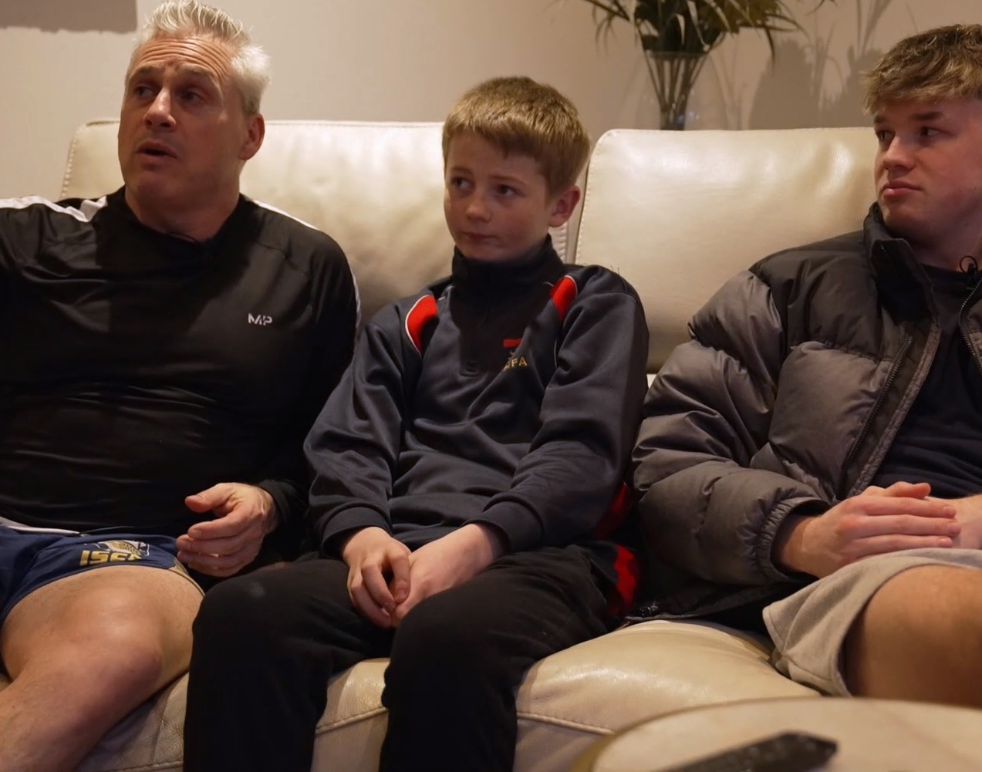
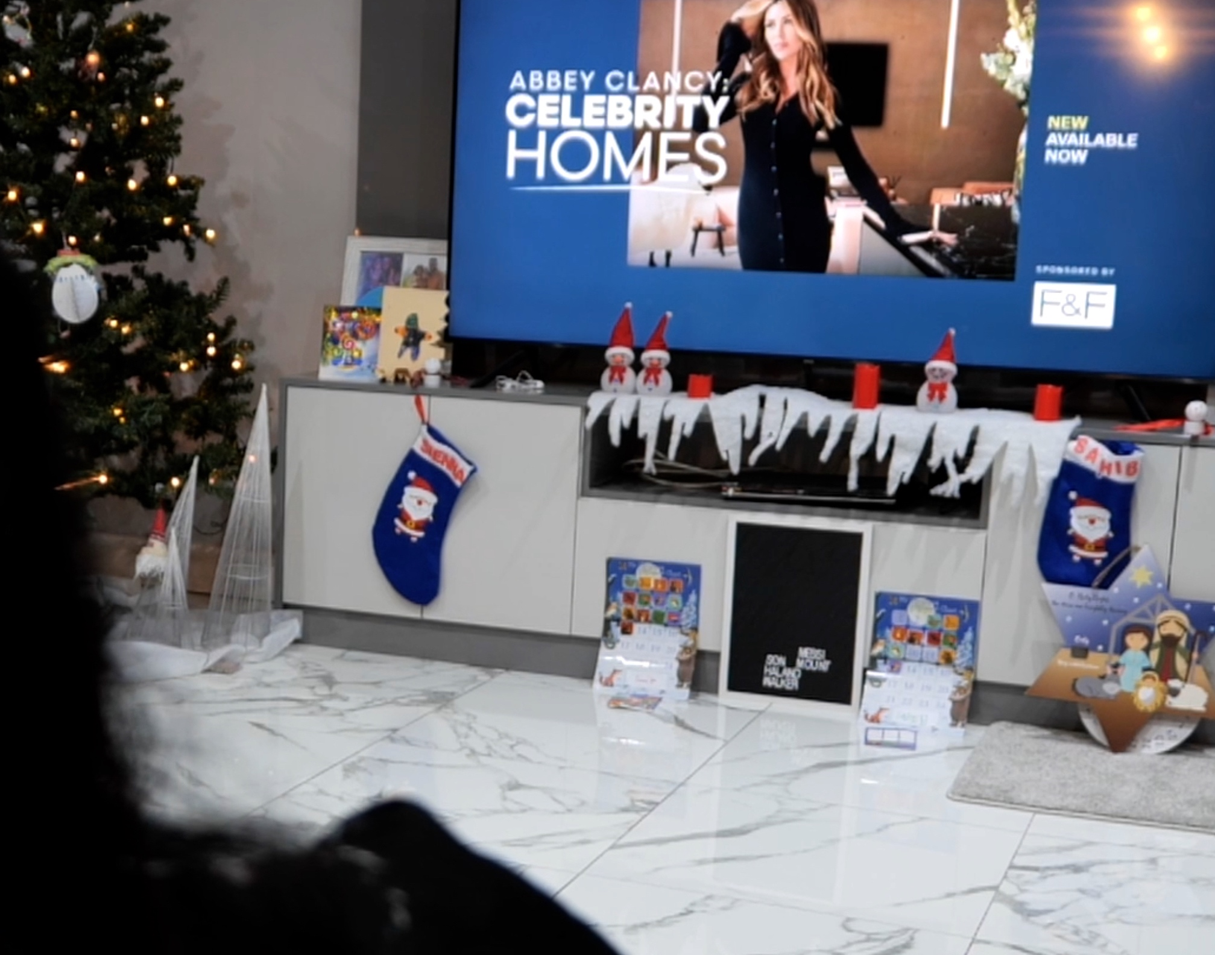
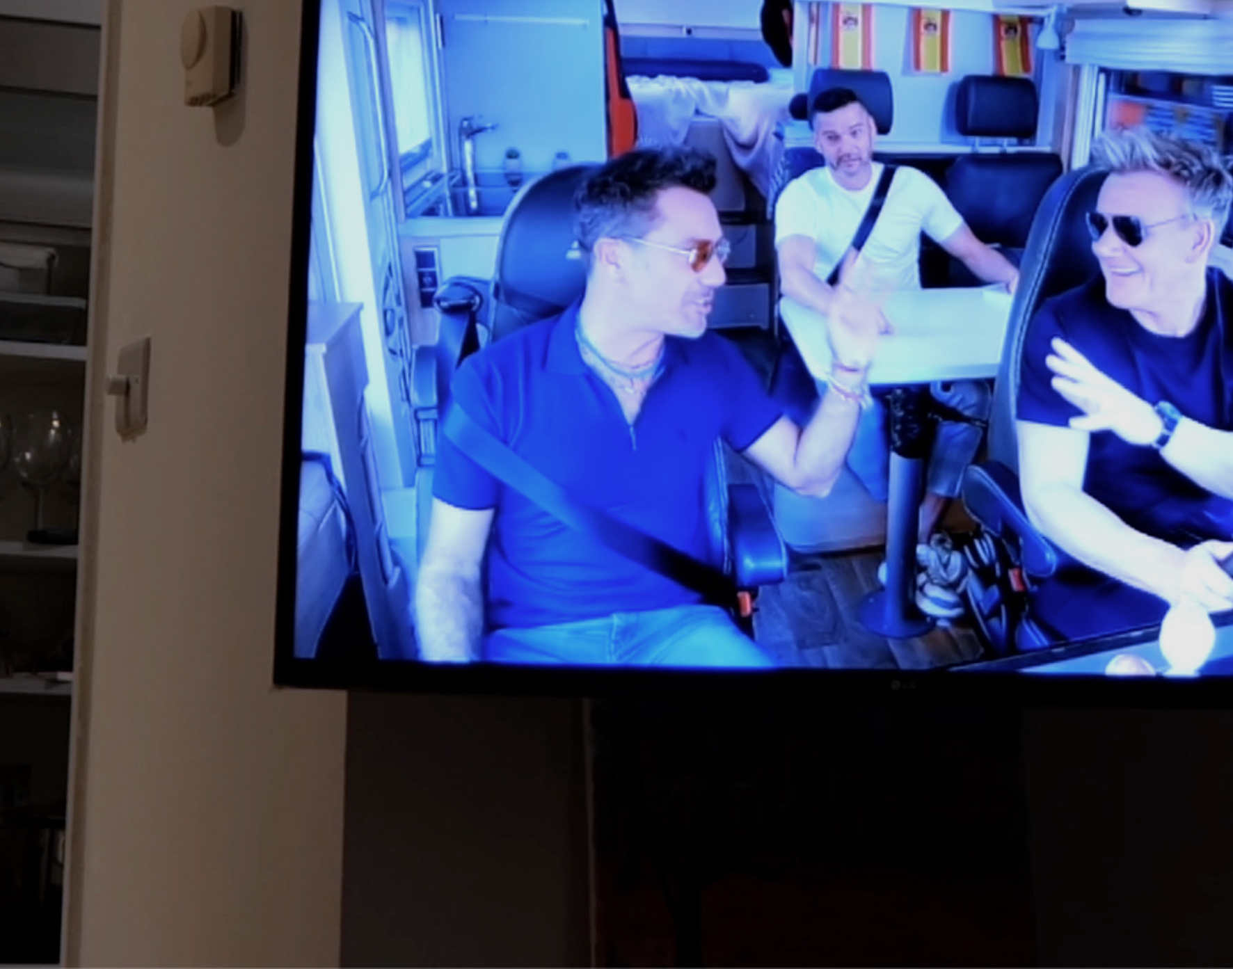
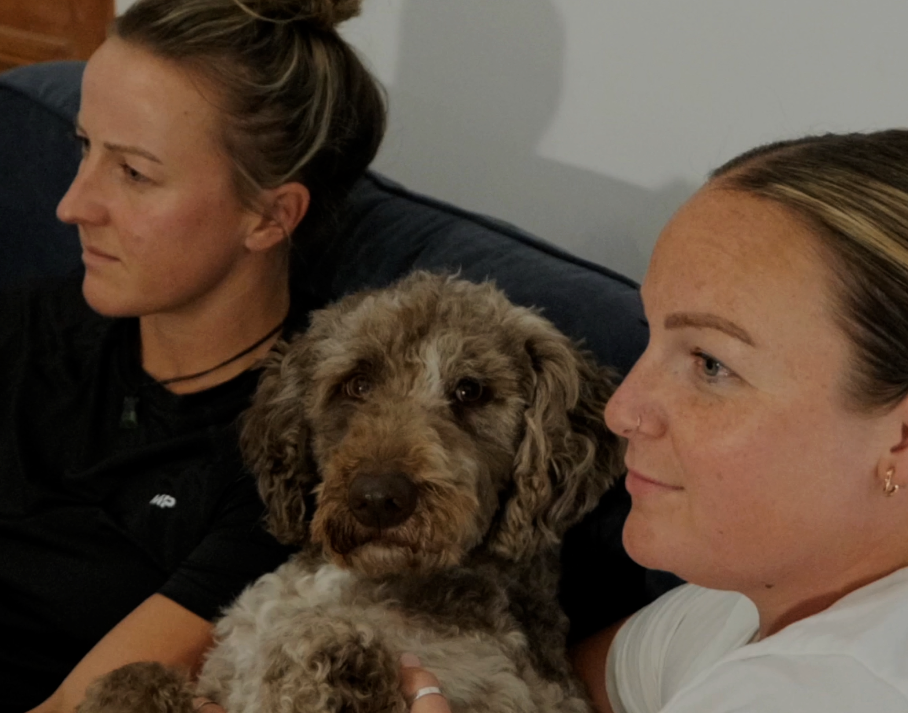
The right in-home advertising context can increase ad recall by up to 6.3 times
+23%
recall when watching with others
+60%
recall watching TV vs. personal device
+44%
higher trust vs. non-professional content
-80%
less intrusive vs. non-professional content
Source: Context Effects, Map The Territory & Tapestry Research, 2024
Notes:
+23% recall when watching with others - The living room makes us more likely to be watching with others in a democratic way
+60% recall watching TV vs. personal device - The living room makes us more likely to be watching on a TV screen
+44% higher trust vs. non-professional content - The living room makes us more likely to be watching professional content
-80% less intrusive vs. non-professional content - Combined this all makes us satisfied and creates an environment where ads are more welcome
Source: Context Effects, Map The Territory & Tapestry Research, 2024
A18. Do you remember seeing any advertising when you watched [OCCASION]? Base: 2,927 viewing occasions with ads answered by 2,017 online respondents aged 18-75 who watched any type of video content via any source the previous day. Sample matched to Barb.
A23. How strongly do you agree or disagree with the following statements when it comes to the ads you saw when you watched [OCCASION]?
Base: 1,950 occasions where ads were recalled (1,499 Professional, 451 Non-professional)

Slide 23

3. ADVANCED TV
Vanguard, ‘V is for Vanguard’

Slide 24
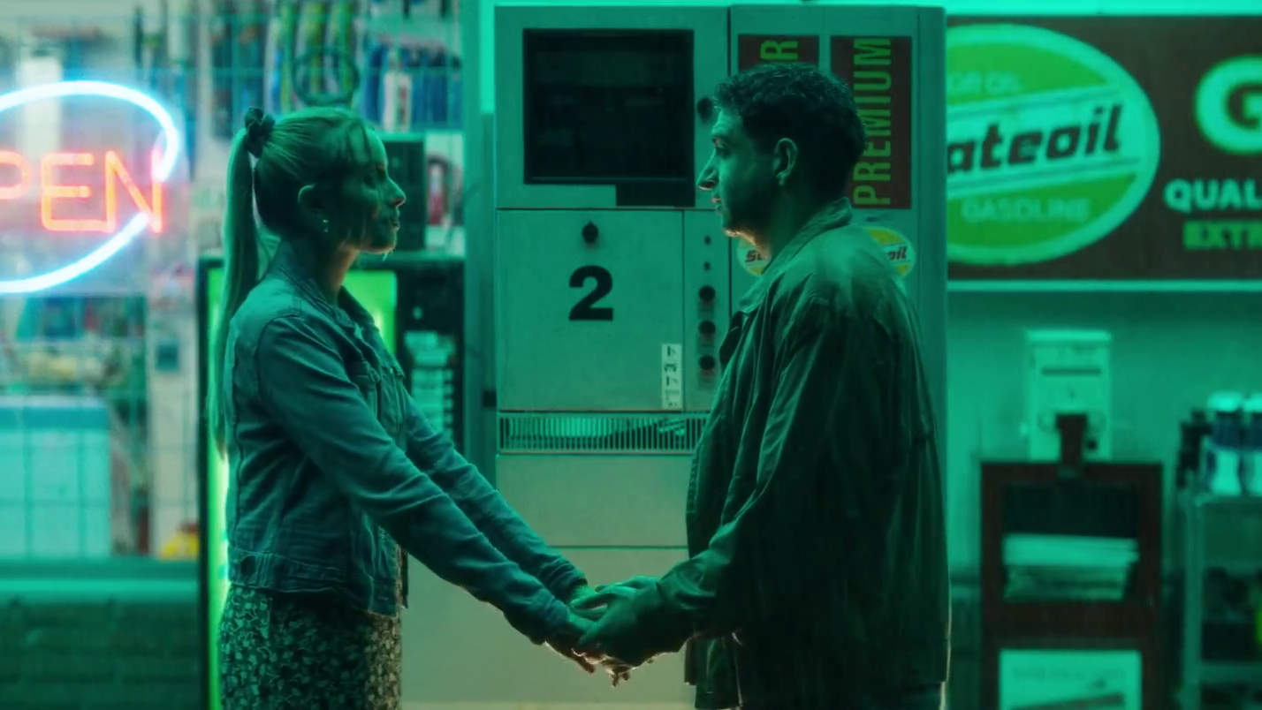

Advanced TV – bringing together the best of both worlds
Best of online:
Dynamic one-to-one ad delivery
Mass first-party data
Best of TV:
Big screen & sound on
Fully viewable & viewed
High quality, brand-safe content
Shared viewing
Domino’s Pizza – Channel 4 & ITVX Idents
Notes:
In this section, we’re going to be delving into the new frontier of TV advertising, exploring how the broadcasters have invested in new technologies and developed advanced advertising opportunities that bring together the best of the internet and TV advertising.

Slide 25

Advanced TV offers unrivalled scale
82% of the population have access to BVOD on a TV set
BVOD represents 11% of all broadcaster TV viewing
Among 16-34s, BVOD accounts for an even greater portion - 24%
Just under 2 hours per person per week
Campo Vejo – Add Some Passion
Source: Touchpoints 2023, Broadcaster data
Notes:
Advanced TV offers not only a high quality, sophisticated ad offering but also unrivalled scale:
82% of the population have access to BVOD on a TV set
11% of all broadcaster TV viewed by individuals is BVOD
Among 16-34s, BVOD accounts for 28% of all broadcaster TV viewing - just under 2 hours per person per week

Slide 26

Fuelled by the richness of broadcasters’ first-party data
ITV – 40m registered users
Channel 4 – 29m registered users
Channel 5 – 9.2m registered users
Sky – 10m+ subscribers
There’s No Deal like a TK Deal – TK Maxx
Source: Broadcaster data
Notes:
The broadcasters are rich in terms of first party data as they require users to register and log-in to use their BVOD services, or to have a contract with their subscribers in the case of Sky.
This kind of scale in terms of high quality, first party data, combined with high time spent and high potential reach, is vital for both highly targeted advertising and mass advertising.

Slide 27

Advanced TV lives in a premium environment
87% of BVOD is viewed on the TV set
97% of ads are played out in full across all broadcaster VOD
Broadcasters are committed to guaranteeing 100% view-through
Lidl – You Got This
Source: Barb / Broadcaster data
Notes:
VOD advertising, unlike many online video platforms, has all the basics you’d expect, in terms of only paying for an ad if it’s played out in full, with 100% viewability and with the sound on.
86.7% of BVOD is viewed on the TV set. (Barb)
View-through rates are crucial for effective video advertising, 97% of all BVOD ads were played out in full from start to finish, but broadcasters are aiming to increase that to 100%.

Slide 28
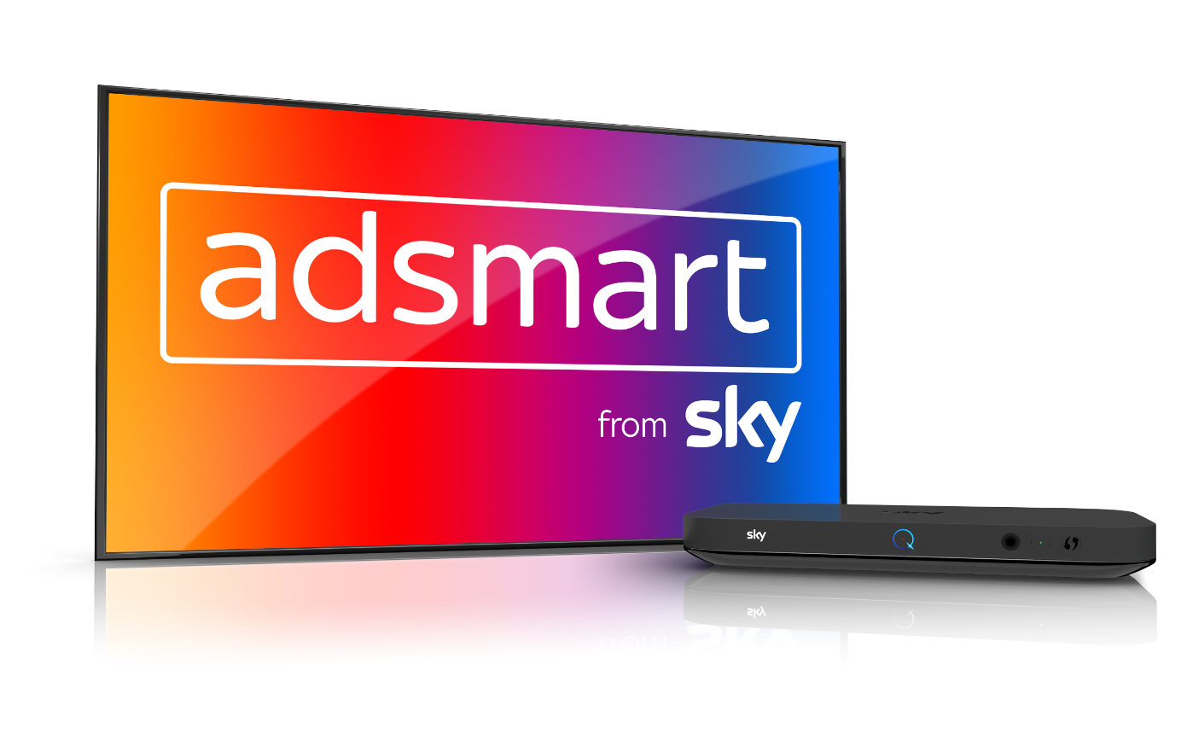
AdSmart from Sky
Fully established and scalable means of accessing advanced TV advertising options
Ads are dynamically inserted into the linear stream when a chosen audience is watching
Can replace ads within linear TV with targeted ads specifically addressed to a given household
Potential reach of 40% of homes or 30m individuals
Notes:
Outside of BVOD, AdSmart from Sky is the other fully established and scalable means of accessing advanced advertising opportunities within the high quality TV environment.
AdSmart works by dynamically inserting ads into the linear stream when a chosen audience is watching
AdSmart is available across the majority of Sky and Virgin Media homes, which means that it’s possible to reach 40% of all homes or 30 million individuals.

Slide 29




Using advanced TV to enhance effectiveness
1. Linear Reach Extension
2. Geo-Targeting
3. Customised Target
Audiences
4. Customer Data-Matching

Slide 30



Using advanced TV to enhance effectiveness
1. Linear Reach Extension
2. Geo-Targeting
3. Customised Target
Audiences
4. Customer Data-Matching

Slide 31

‘Middle tier’ of viewers are key to BVOD’s incremental reach
All viewers split into tenths based on their weight of linear TV viewing
Linear
0-19%
Lightest tier
Middle tier 20-49%
Heaviest tier 50-100%
BVOD
% contribution to viewing
Source: PwC UK, Barb, all viewers split into tenths based upon their weight of linear TV viewing
Notes:
PwC’s analysis in ‘BVOD Almighty: Reach and Return’ found that, on average, BVOD adds a 4% increase in incremental Adult (16+) reach to a linear TV campaign, a 6% increase for Adult ABC1s, and an 8% increase for 16-34s.
Among the top performing 10% of campaigns, the percentage increase rises to 9% for Adults, 8% for Adult ABC1s, and 11% for 16-34s.
One of the main reasons for this incremental reach is the ease of reaching light linear TV viewers on BVOD – specifically the ‘middle tier’.
The middle tier is the 20-49% decile group in terms of linear TV viewing who also heavily over index on BVOD. They account for 7% of total linear TV viewing but 28% of BVOD consumption.

Slide 32
BVOD provides good odds of reaching an attractive audience
Lightest tier
0-19%
Middle tier
20-49%
Heaviest tier
50-100%
Hard to reach via TV
TV reach extenders
Easily reachable via linear TV
Average odds of reaching segment per exposure
Linear: 1 in 185
Linear: 1 in 14
Linear: 1 in 1.1
BVOD: 1 in 12
BVOD: 1 in 4
BVOD: 1 in 2
Average linear TV viewing per day
8 minutes
49 minutes
5 hours and 24 minutes
skews towards:
ABC1 adults (71%) and 16-34 adults (42%)
Source: PwC UK, Barb, all viewers split into tenths based upon their weight of linear TV viewing
Notes:
Analysis shows that the chance of reaching somebody in this attractive group with a spot on linear TV is 1 in 14.
But on BVOD, it only takes four impressions to, on average, reach somebody in the middle tier. As such, on average, using BVOD is three and a half more efficient than linear at reaching the middle tier of viewers.
The middle tier are very attractive audiences for many advertisers (proportionally younger and upscale) and BVOD enables them to be reached in an efficient way.

Slide 33

Using advanced TV to enhance effectiveness
1. Linear Reach Extension
2. Geo-Targeting
3. Customised Target
Audiences
4. Customer Data-Matching

Slide 34

Geo-targeting
Smaller businesses with local footprints
Upweighting spend to postcodes in close proximity to stores
Restricting activity to post codes where promotions run
Geo-based creative targeting
reland - Jamie-Lee Donnell & Saoirse-Monica Jacson
Notes:
Geo-targeting (or geography based addressability) is also available through BVOD and AdSmart from Sky.
By providing a list of predefined postcodes to broadcasters, smaller businesses can hyper-target people who live within their catchment areas only.
Larger businesses can upweight campaigns in areas where they have a high number of stores, or to those postcodes that are within a certain distance from their stores.
Advertisers can run offers in certain areas but not in others to ensure that customers who aren’t open to the offer don’t see the ad.
It’s also possible to run different versions of creative based on the location of the viewer watching the ad.

Slide 35
Using advanced TV to enhance effectiveness
1. Linear Reach Extension
2. Geo-Targeting
3. Customised Target
Audiences
4. Customer Data-Matching

Slide 36
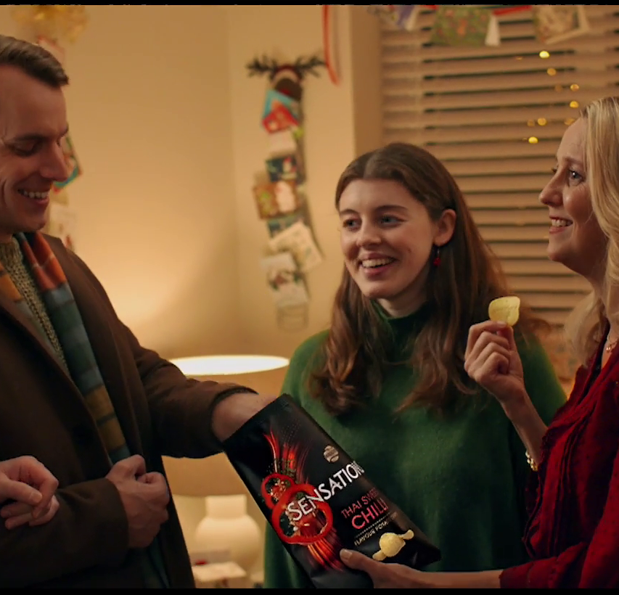
Customised target audiences
Additional data sources offered by broadcasters:
Historic viewing data
Viewer panel data
3rd party data providers
Walkers – Made for Sharing
Notes:
In addition to standard buying audiences, all of the sales houses offer a huge array of more targeted, customisable audiences that can be bought by combining their first party registration or customer data sets with other data sources that they have access to:
Audiences can be created based on historic viewing preferences, patterns or interests.
Using viewer panels, broadcasters can combine more detailed viewer data alongside their first party data to create custom ‘lookalike’ audiences.
High quality data sets from 3rd party data providers (like Experian or Mastercard) can be matched against the broadcasters’ own data through sophisticated, data compliant means.

Slide 37


Using advanced TV to enhance effectiveness
1. Linear Reach Extension
2. Geo-Targeting
3. Customised Target
Audiences
4. Customer Data-Matching

Slide 38
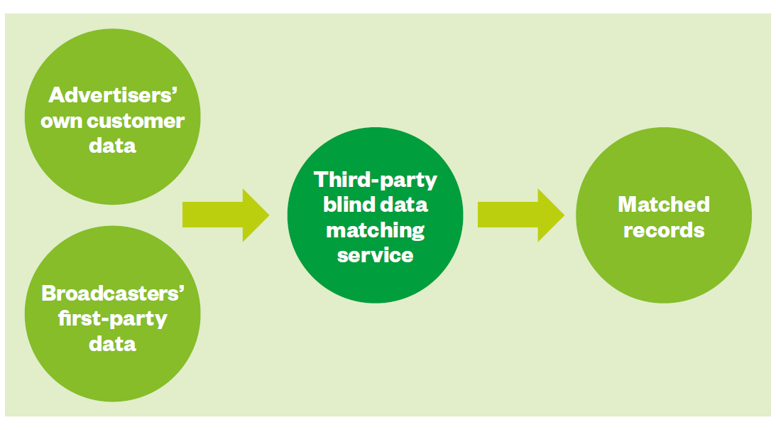
Customer data-matching & opportunities for targeting
Targeting opportunities:
Existing customers or non-customers
Customers approaching a renewal date
Customers likely to churn
Those who could benefit from another product / service
Different creative executions based on customer insight
Notes:
Through customer data matching, broadcasters offer a means of combining advertisers’ own customer data sets with the broadcasters’ own 1st party data.
This is done by a 3rd party company taking both datasets and blind-matching individuals in a completely secure, GDPR compliant way.
This sort of data matching opens up a whole range of targeting opportunities.

Slide 39

BVOD & AdSmart Pricing
Doesn’t fluctuate with supply and demand like linear TV but operates on fixed cost per thousand (CPM)
Ratecard mainly varies based on degree of targeting with some seasonal variation based on demand
No advanced booking required but incentives for early booking
Most VOD bought through agencies and now available programmatically
Vinted - Clothes
Notes:
Advanced TV advertising has always been bought distinctly to linear TV.
Pricing doesn’t fluctuate with supply and demand in the same way linear TV does, instead operating on fixed cost per thousands, or CPM. These prices are fixed, but the ratecard will vary depending on how tightly defined the target audience is or the degree of complexity and process required to deliver the target audience. Some seasonal variations come into play with VOD pricing based on demand, but it’s not dictated by market supply and demand mechanics.
Unlike linear TV, VOD doesn’t require advanced booking, although there are some incentives for early booking. Linear TV needs some form of advanced booking to help broadcasters be efficient with their airtime and deliver against deals. As VOD is one to one delivery (taking audience efficiencies out of the equation) and broadcasters can increase ad loads if required, there’s less need for a lead time between booking and placement.
Most VOD campaigns are bought through media agencies however, this practice is rapidly evolving. TV is becoming more automated, sophisticated and data driven, which means that agencies can completely automate the way they buy audiences from the broadcaster VOD players:
ITV’s Planet V offer a means for advertisers and agencies to plug their own trading desks in so they can directly place orders against their custom audiences.
Channel 4 operate on a DSP agnostic basis, and have partnerships already formed with The Trade Desk and Adobe, who can plug into Channel 4’s SSP Freewheel, and they also have integrations with Google’s DSP called DV360.
Sky's AVX proposition offers access to long-form VOD ad inventory via their partnerships with Freewheel and Adobe DSP and continues to evolve to become DSP agnostic.

Slide 40
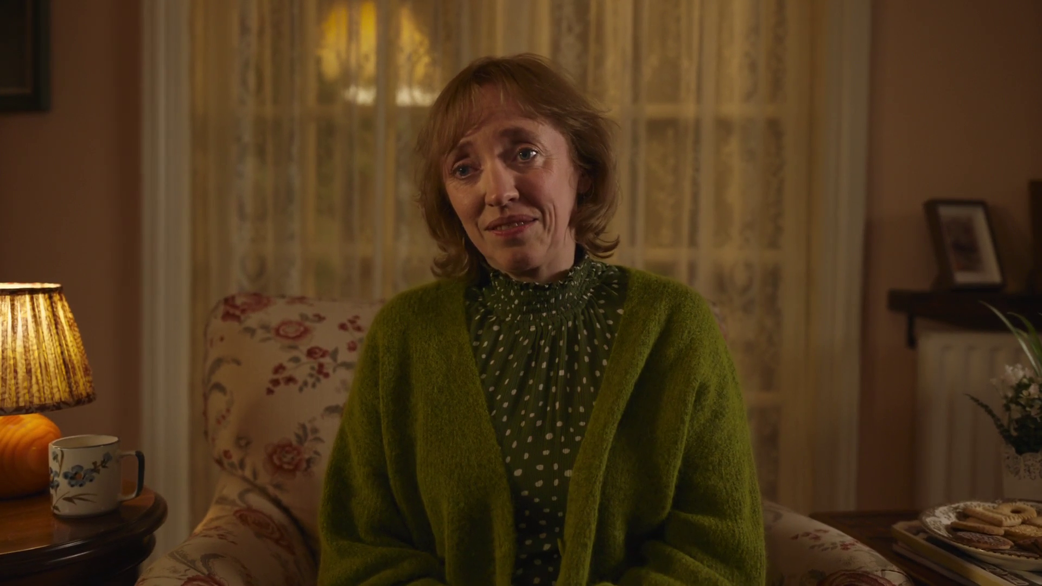
4. IT’S FOR EVERYONE
Boots. ‘Pipe Down’

Slide 41
671 advertisers spent less than £50k on TV in 2023
Source: Nielsen Ad Intel, 2023
Notes:
Looking at the make-up of TV advertisers across 2023, 671 - which is 30% of all advertisers - spent less than £50k on TV and 1,168, which is 52%, spent less than £250k. 30% of all advertisers spent over a million pounds and 5% spent over ten million.

Slide 42

Average TV view costs 0.65p (in 2023)
The average cost
of buying the media space to get one
person in the UK
to see a TV (linear and VOD) advert
costs over half a penny
Source: 2023, Thinkbox estimates using AA/WARC
Notes:
The average cost of buying the media space to enable one person in the UK to see a TV (linear and VOD) advert only costs just under a penny.

Slide 43
TV remains the lowest priced video channel
Average cost per 30 second (000s)
Other online video
£131.03
TV
YouTube
£13.86
£6.50
Source: 2023, Thinkbox estimates using AA/WARC (estimates), Barb, ViewersLogic, IPA TouchPoints 2023
Notes:
The chart combines AA/WARC revenue estimates, with the video advertising time data to create a relative cost per 30 seconds of AV ad exposure.
Spot TV advertising (linear and BVOD) averages £7 per thousand exposures. YouTube is just over double at £14. Other online video however is £131.

Slide 44
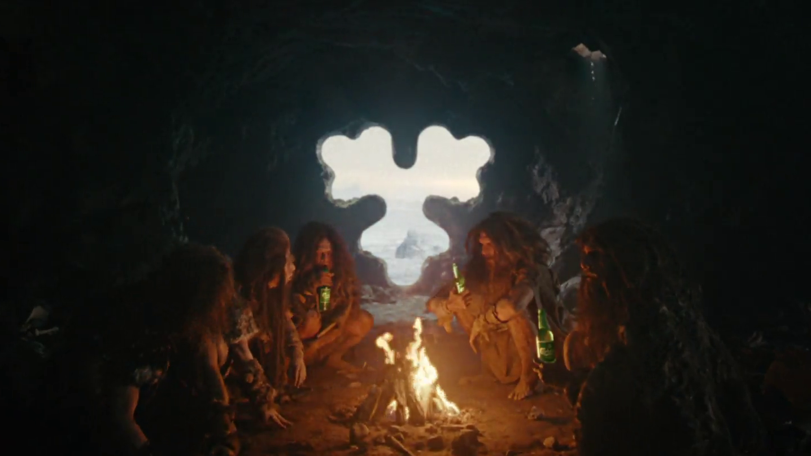
5. THE BUSINESS CASE FOR ADVERTSING
Carlsberg, ‘Curiosity’

Slide 45

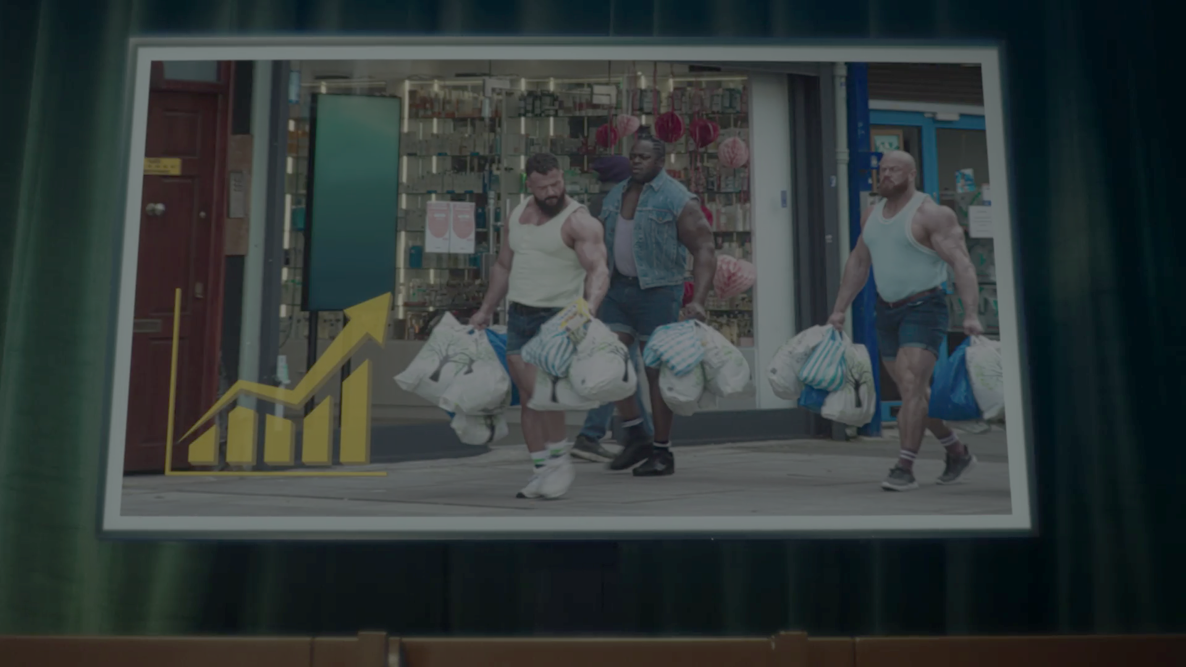






Profit Ability 2 database: quality, independence, current
5 Agencies
10 Media channels
14 Sectors
141 Brands (total)
53 (matched pre & post Covid)
5 Agencies
10 Media channels
£1.8bn
Media spend analysed
Quality: Market Mix Modelling - gold standard for media effectiveness
Independent: Client data from models already commissioned and paid-for by the respective brand
Current: Just campaigns from 2021–2023 to enable post-Covid market understanding
Notes:
So we thought we needed to revisit the PA work and bring it bang up to date – to look at more media channels, more sectors and to structure the database in such a way that we could provide a clean read on the state of advertising delivery post the Covid pandemic lockdowns.
So we build the Profit Ability 2 databank… the ultimate media effectiveness databank to provide the first post-Covid analysis of advertising’s financial impact:
5 modelling agencies
141 brands
£1.8bn worth of spend across last 3 years – focused on latest data to understand what’s going on right now – breakdown by year in the footnote.
14 sectors are represented – 7 will be reported individually
10 media channels
For 53 of brands, we were able to do proper before & after matching for COVID period to see how effectiveness has changed since 2018-’19 vs. today.

Slide 46
Sustained effects are substantial: c.60% of total profit volume
Full Payback
Short-Term Payback
(up to 13 weeks)
Source: Profit Ability 2, April 2024 – Short term benchmarks: Ebiquity, EssenceMediacom, Gain Theory, Mindshare, Wavemaker UK.
Long Term Multipliers: EssenceMediacom, Gain Theory, Mindshare, Wavemaker UK
Notes:
That's the short-term effect but what’s interesting when digging into the data, is that the short-term effect is actually the minority of all advertising effect
Looking at the payback of all advertising over the 3 time horizons, about 24% of the advertising effect is within the week of advertising (immediate payback) – so the effect generated right now by putting ads out into the market is about ¼ of the total effect
There's then a further 18%, that is the carryover effect - people seeing ads this week, responding in the shortish term
Combined, this is the short-term payback
What is really striking is just under 60% of advertising's contribution is that sustained long-term effect - by building the brand, that's where the majority of advertising's payback is.
It varies a lot sector to sector, & channel to channel, but the general direction is most of advertising's payback in most channels is through that sustained effect
Add the sustained payback to the ST payback & you get the full payback

Slide 47
Immediate payback not exclusive to ‘performance’ media
Source: Profit Ability 2, April 2024 – Short term benchmarks: Ebiquity, EssenceMediacom, Gain Theory, Mindshare, Wavemaker UK.
Immediate contribution = the same week of advertising exposure
Notes:
Looking at how channels are able to deliver immediate payback, Generic PPC comes top with 30.5% of total immediate volume return.
But what is also clear, and maybe unexpected, is that immediate payback is not the exclusive domain of ‘performance’ media – Linear TV delivers over one-fifth of total return.

Slide 48
‘Traditional’ media (TV, Audio, Print) still deliver in short-term
Source: Profit Ability 2, April 2024 – Short term benchmarks: Ebiquity, EssenceMediacom, Gain Theory, Mindshare, Wavemaker UK. Immediate contribution = the same week of advertising exposure.
Carryover contribution = the contribution within 13 weeks of ad exposure
Notes:
So what does this mean for the total short-term profit payback – i.e. immediate and carryover combined?
If we’re optimising to a 3-month window, nothing can beat Linear TV (34% of volume delivery)
Generic PPC is still pretty strong (22.5%)
Also Audio, BVOD and Print bring themselves into play as ‘performance’ drivers
However, 3-months is still pretty short period to be optimising over…

Slide 49
Linear TV: unmatched as the total Profit ROI volume driver
Source: Profit Ability 2, April 2024 – Short term benchmarks: Ebiquity, EssenceMediacom, Gain Theory, Mindshare, Wavemaker UK. Long Term Multipliers: EssenceMediacom, Gain Theory, Mindshare, Wavemaker UK. Immediate contribution = same week as advertising, Carryover = within 13 weeks, Sustained = within 2 years
Notes:
Adding in the sustained effect enables you to see the total profit delivery position.
Considering all three speeds of payback Linear TV is unmatched as the full profit volume driver – delivering c. 47% of total volume.

Slide 50
TV is the biggest single source of website traffic
Contributing 42% of all visits, around 50m in all
Breakdown of web visits by driver
Source: Magic Numbers, The TV playbook for online businesses (2021)
Notes:
Analysis across the brands consistently showed a clear relationship between TV activity and web traffic.
Uplift was seen regardless of the level of investment or the size of the launch
likely impacted by the ease and convenience of searching immediately via a mobile device.
Across the 10 brands modelled, 120m visits were generated, with TV driving 42% of all visits - equivalent to 50 million in total

Slide 51

TV advertising drove uplifts in search for Chocomel
R^{2=0.83}
Source: Barb/Google Trends, Jan 2023 – Dec 2023

Slide 52

TV advertising drove uplifts in search for Abba Voyage
R^{2=0.89}
Source: Barb/Google Trends, Jan 2023 – Dec 2023

Slide 53

TV advertising drove uplifts in search for Who Gives a Crap
R^{2=0.67}
Source: Barb/Google Trends, Jan 2023 – Dec 2023

Slide 54
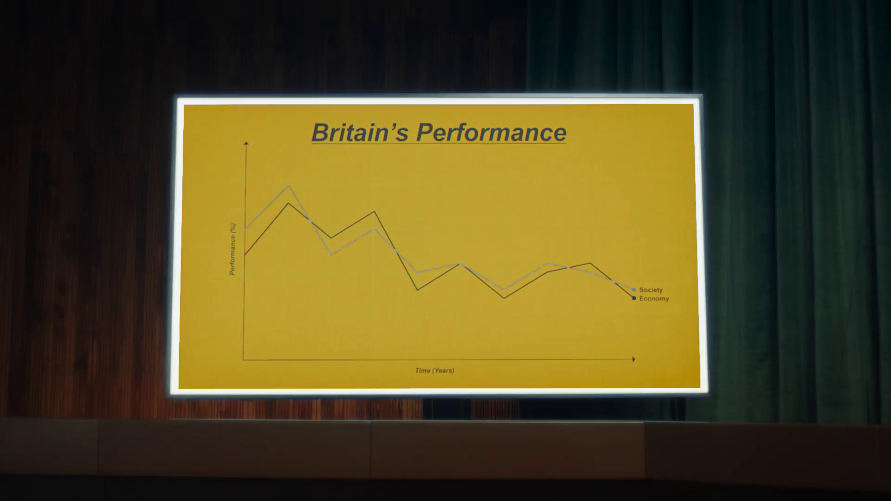
A few final things
Wheatabix, ‘Fixing Britain’

Slide 55
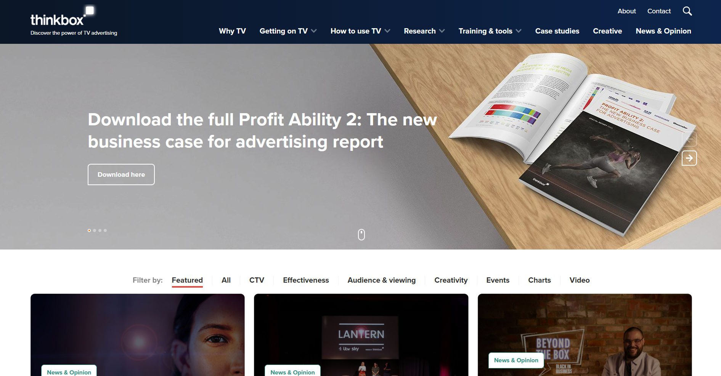

Slide 56

Notes:
For those who really want to get stuck in – we have a free online training course in all things TV advertising – called TV Masters
It’s fully accredited by the IPA, and since launching it in lockdown we’ve had just over 5,000 people complete it
So incredibly popular for those who really want up their education

Slide 57
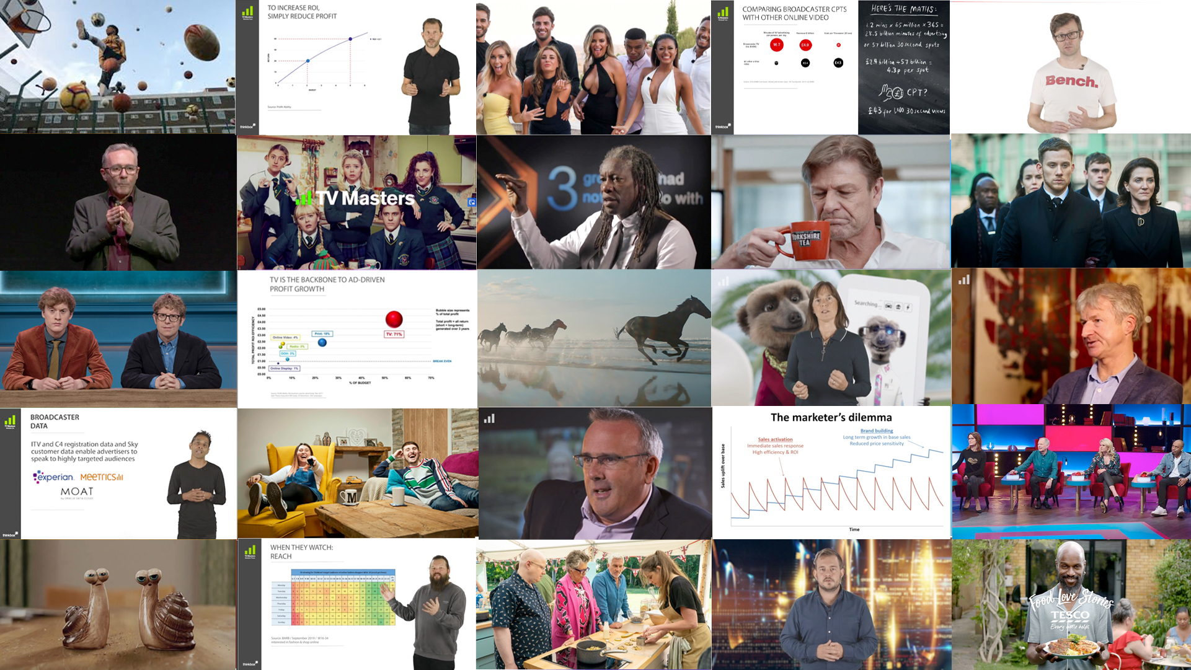
Notes:
Here’s a quick snapshot of what it looks like – all video learning, lots of TV examples to bring it to life
Next course starts on Monday 11th September – so just search ‘TV Masters’ if you’re interested in that (not the TV installation company in Chiswick, we’re the other one)

Slide 58

Thank you,
Any questions?
HP, ‘Wise Moves’

